Slide 1
Group 3 Project Title: Restaurant Website
MEET THE TEAM
MOHAMMED ABDULLAH ( Team Leader )
Syed inthiqhab alaM

Slide 2
Presentation Flow
Introduction
Problem Statement
Project Goal
Objective
Architecture Diagram
Design
Conclusion
Reference

Slide 3
Introduction
The purpose of this project is to develop a modern restaurant website that highlights the brand, ambiance, and menu while enabling seamless online ordering. It bridges traditional dining with digital convenience, meeting the evolving expectations of contemporary diners and enhancing customer engagement and satisfaction.

Slide 4
Problem Statement
Manual order taking leads to errors.
Long queues during peak hours.
Lack of real-time order tracking.
Poor data management and analytics.
Dependence on third-party delivery platforms with high commissions.

Slide 5
Project Goal
To develop a user-centric restaurant platform with responsive design, intuitive navigation, real-time order management, and admin controls using MERN Stack, Next.js, Vite, Clerk for scalable, high-performance, SEO-friendly operations.

Slide 6
Objectives
To provide a user-friendly restaurant website.
To enable seamless online food ordering.
To reduce order processing time.
To improve accuracy and customer satisfaction.
To support restaurant owners with analytics and insights

Slide 7
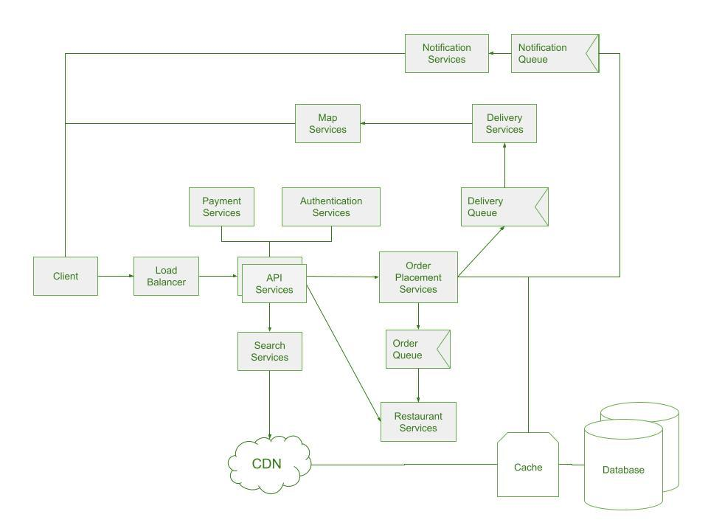
Architecture Diagram
Frontend communicates with backend APIs.
Backend processes business logic.
Database stores user, order, and menu data.
Payment gateway handles transactions

Slide 8
Design
Collection | Key Fields
users | _id, name, email, password, phone, addresses[]
menu_items | _id, name, description, price, category, image, available
orders | _id, user_id, items[], total, status, timestamp
categories | _id, name, description, display_order
inventory | _id, item_name, quantity, threshold, unit

Slide 9


Conclusion
The proposed system offers an integrated, secure, and scalable platform that enhances efficiency, accuracy, customer satisfaction, and supports restaurant digital transformation

Slide 10
Reference
[21] Squarespace. (2025, November 20). 5 best restaurant website examples for 2026. https://www.squarespace.com/blog/restaurant-website-design-examples
[22] YouTube. (2021, November 22). 10 best restaurant website examples of 2026. https://www.youtube.com/watch?v=xe6xcF1Zchk
[23] Scribd. (2025, June 18). Restaurant management system database schema. https://www.scribd.com/document/455694826/DB-Schema-docx
[24] Visual Paradigm Online. (2024, December 31). Restaurant service flowchart. https://online.visual-paradigm.com/diagrams/templates/flowchart/restaurant-service-flowchart
[25] Dev.to. (2024, December 13). Next.js vs React performance: A comprehensive comparison. https://dev.to/jhk_info/next-js-vs-react-performance-a-comprehensive-comparison-4fgc
[26] Microsoft Tech Community. (2024, December 2). Building a restaurant management system with Azure Database for MySQL. https://techcommunity.microsoft.com/blog/adformysql/building-a-restaurant-management-system-with-azure-database-for-mysql/429710
[27] Custellence. (2024, October 22). Delivery and food order customer journey map template. https://www.custellence.com/restaurant-food-ordering-and-delivery-customer-journey-map-template/
[28] Shivlab. (2025, March 10). Next.js vs React: Which one is best for building web apps. https://shivlab.com/blog/nextjs-vs-react-which-one-is-best-for-web-apps/
[29] Adobe Business. (2025, May 28). User flow diagrams and analysis | Customer journey analytics. https://business.adobe.com/products/adobe-analytics/customer-journey-analytics/flow-diagrams.html
[30] Nishit Hacks. (2024, January 20). React vs. Next.js: Unveiling performance secrets for web developers. https://nishithacks.hashnode.dev/react-vs-nextjs-unveiling-performance-secrets-for-web-developers
[31] Scribd. (2024, January 1). Restaurant website overview. https://www.scribd.com/document/640185044/Restaurant-Website

Slide 11

THANK YOU

